Slide 1




Hands on Camembert Building a dialog act classification model for French
Benjamin Muller Roman Castagne Nathan Godey INRIA Paris

Slide 2
Hands on Camembert
Session 1 [lecture]: Dialog Act Classification with Camembert~~~
Session 2 [coding]: Camembert Language Modeling ~~~~~~~~~
Session 3 [coding]: Building a supervised model for dialog act prediction for French with Camembert~~~~~~~~~~~~~~~~~~~

Slide 3
Hands on Camembert: Session 1
Framework: Focus on Dialog Act Prediction
Task-Specific Modeling
Segmentation
The Transformers Architecture
Training
The Camembert model

Slide 4

Acknowledgement
We built Camembert in 2019 as part of a collaboration between INRIA Paris (ALMANACH team) and Facebook AI
Work done by Louis Martin, Pedro Ortiz, Benjamin Muller with the guidance of Yoann Dupont, Laurent Romary, Éric Villemonte de la Clergerie, Djamé Seddah and Benoît Sagot
Camembert derived from BERT (released by Google in 2018) and ROBERTa (released by Facebook in 2019).

Slide 5


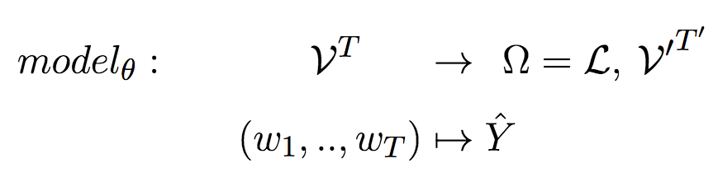
Framework
Given a sequence of tokens our goal is to find the best model to predict a label or sequence of labelY
We may want to
assign a category to each word (sequence labeling)
assign a category to each sentence (sequence classification)
Generate a sequence (sequence generation)

Slide 6
Framework
Given a sequence of tokens our goal is to find the best model to predict a label or sequence of labelY
In this tutorial
We will build a Dialog Act Classification model for French
Notes:
Get labels from dataset:
label, label_i = [], []
for e in miam_dataset["validation"]:
if e["Dialogue_Act"] not in label:
label.append(e["Dialogue_Act"])
if e["Label"] not in label_i:
label_i.append(e["Label"])
print(len(label), len(label_i))
print(label)
['greet', 'ask', 'next_step', 'inform', 'staff_enterprise', 'yes', 'quit', 'todo_irreparable', 'help', 'inform_material_space', 'no', 'ack', 'other', 'quality_control', 'manufacturing_reqs', 'find_mold', 'inform_job', 'informer_elcomps', 'first_step', 'todo_failure', 'find_plans', 'staff_job', 'informer_decoration', 'security_policies', 'informer_end_manufacturing', 'informer_conditioner', 'inform_engine', 'kindAtt', 'studies_job']

Slide 7
Dialog Act Classification Model
We build a Dialog Act Classification model for French
Ask
Déjà de retour avec les plans ?! Bravo les jeunes, vous avez fait vite !
help
Greet
inform
…
Next step
Notes:
Get labels from dataset:
label, label_i = [], []
for e in miam_dataset["validation"]:
if e["Dialogue_Act"] not in label:
label.append(e["Dialogue_Act"])
if e["Label"] not in label_i:
label_i.append(e["Label"])
print(len(label), len(label_i))
print(label)
['greet', 'ask', 'next_step', 'inform', 'staff_enterprise', 'yes', 'quit', 'todo_irreparable', 'help', 'inform_material_space', 'no', 'ack', 'other', 'quality_control', 'manufacturing_reqs', 'find_mold', 'inform_job', 'informer_elcomps', 'first_step', 'todo_failure', 'find_plans', 'staff_job', 'informer_decoration', 'security_policies', 'informer_end_manufacturing', 'informer_conditioner', 'inform_engine', 'kindAtt', 'studies_job']

Slide 8
Dialog Act Classification Model
We build a Dialog Act Classification model for French
Ask
Déjà de retour avec les plans ?! Bravo les jeunes, vous avez fait vite !
help
Greet
inform
…
Input is a transcripted dialog utterance
Next step
Label is a dialog act [29 possible labels]
Notes:
Get labels from dataset:
label, label_i = [], []
for e in miam_dataset["validation"]:
if e["Dialogue_Act"] not in label:
label.append(e["Dialogue_Act"])
if e["Label"] not in label_i:
label_i.append(e["Label"])
print(len(label), len(label_i))
print(label)
['greet', 'ask', 'next_step', 'inform', 'staff_enterprise', 'yes', 'quit', 'todo_irreparable', 'help', 'inform_material_space', 'no', 'ack', 'other', 'quality_control', 'manufacturing_reqs', 'find_mold', 'inform_job', 'informer_elcomps', 'first_step', 'todo_failure', 'find_plans', 'staff_job', 'informer_decoration', 'security_policies', 'informer_end_manufacturing', 'informer_conditioner', 'inform_engine', 'kindAtt', 'studies_job']

Slide 9
Dialog Act Classification Model
We build a Dialog Act Classification model for French
Ask
Il faut que tu trouves l' adresse de l' entreprise de plasturgie
help
Greet
inform
…
Input is a transcripted dialog utterance
Next step
Label is a dialog act [29 possible labels]
Notes:
Get labels from dataset:
label, label_i = [], []
for e in miam_dataset["validation"]:
if e["Dialogue_Act"] not in label:
label.append(e["Dialogue_Act"])
if e["Label"] not in label_i:
label_i.append(e["Label"])
print(len(label), len(label_i))
print(label)
['greet', 'ask', 'next_step', 'inform', 'staff_enterprise', 'yes', 'quit', 'todo_irreparable', 'help', 'inform_material_space', 'no', 'ack', 'other', 'quality_control', 'manufacturing_reqs', 'find_mold', 'inform_job', 'informer_elcomps', 'first_step', 'todo_failure', 'find_plans', 'staff_job', 'informer_decoration', 'security_policies', 'informer_end_manufacturing', 'informer_conditioner', 'inform_engine', 'kindAtt', 'studies_job']

Slide 10
Building a NLP Model
How do we segment the input text ?
How do we parametrize the model?
How do we train the model?

Slide 11
Building a NLP Model: In this Tutorial
How do we segment the input text ?
We use sentencepiece tokenization which is a data-driven sub-word segmentation algorithm
How do we parametrize the model?
How do we train the model?

Slide 12
Tokenization
Tokenization is the first step of everything we do in NLP
It consists in segmenting raw text to define our modeling units (tokens)
E.g.: Il faut que tu trouves l' adresse de l' entreprise de plasturgie

Slide 13
Tokenization
Tokenization is the first step of everything we do in NLP
It consists in segmenting raw text to define our modeling units (tokens)
E.g.: Il faut que tu trouves l' adresse de l' entreprise de plasturgie
Word level segmentation
['Il', 'faut', 'que', 'tu', 'trouves', "l'", 'adresse', 'de', "l'", 'entreprise', 'de', 'plasturgie']

Slide 14
Tokenization
Tokenization is the first step of everything we do in NLP
It consists in segmenting raw text to define our modeling units (tokens)
E.g.: Il faut que tu trouves l' adresse de l' entreprise de plasturgie
Word level segmentation
['Il', 'faut', 'que', 'tu', 'trouves', "l'", 'adresse', 'de', "l'", 'entreprise', 'de', 'plasturgie']
What happens for an unknown word at test time?

Slide 15
Tokenization
Tokenization is the first step of everything we do in NLP
It consists in segmenting raw text to define our modeling units (tokens)
E.g.: Il faut que tu trouves l' adresse de l' entreprise de plasturgie
Word level segmentation → Limit: Out-of-Vocabulary Problem
['Il', 'faut', 'que', 'tu', 'trouves', "l'", 'adresse', 'de', "l'", 'entreprise', 'de', UNK]

Slide 16
Tokenization
Tokenization is the first step of everything we do in NLP
It consists in segmenting raw text to define our modeling units (tokens)
E.g.: Il faut que tu trouves l' adresse de l' entreprise de plasturgie
Word level segmentation → Limit: Out-of-Vocabulary Problem
Character-Level Segmentation
['I', 'l', ' ', 'f', 'a', 'u', 't', ' ', 'q', 'u', 'e', ' ', 't', 'u', ' ', 't',....

Slide 17
Tokenization
Tokenization is the first step of everything we do in NLP
It consists in segmenting raw text to define our modeling units (tokens)
E.g.: Il faut que tu trouves l' adresse de l' entreprise de plasturgie
Word level segmentation → Limit: Out-of-Vocabulary Problem
Character-Level Segmentation → Limit: Too Long Sequences
['I', 'l', ' ', 'f', 'a', 'u', 't', ' ', 'q', 'u', 'e', ' ', 't', 'u', ' ', 't',....

Slide 18
Tokenization
Tokenization is the first step of everything we do in NLP
It consists in segmenting raw text to define our modeling units (tokens)
E.g.: Il faut que tu trouves l' adresse de l' entreprise de plasturgie
Word level segmentation → Limit: Out-of-Vocabulary Problem
Character-Level Segmentation → Limit: Too Long Sequences
Sentencepiece
Segment at the word-level except for infrequent words that are segmented at the subword level

Slide 19
Tokenization
Tokenization is the first step of everything we do in NLP
It consists in segmenting raw text to define our modeling units (tokens)
E.g.: Il faut que tu trouves l' adresse de l' entreprise de plasturgie
Word level segmentation → Limit: Out-of-Vocabulary Problem
Character-Level Segmentation → Limit: Too Long Sequences
Sentencepiece → Tradeoff between both approaches
Segment at the word-level except for infrequent words that are segmented at the subword level ['▁Il','▁faut','▁que','▁tu','▁trouve','s','▁l',"'",'▁adresse','▁de','▁l',"'",'▁entreprise','▁de','▁','plast','ur','gie']

Slide 20
Building a NLP Model: In this Tutorial
How do we segment the input text ?
We use sentencepiece tokenization which is a data-driven sub-word segmentation algorithm
How do we parametrize the model?
We use the transformer architecture
How do we train the model?

Slide 21
Recall
Given a sequence of tokens our goal is to find the best model to predict a label or sequence of labelY
We want to build a Dialog Act Classification model for French
Notes:
Get labels from dataset:
label, label_i = [], []
for e in miam_dataset["validation"]:
if e["Dialogue_Act"] not in label:
label.append(e["Dialogue_Act"])
if e["Label"] not in label_i:
label_i.append(e["Label"])
print(len(label), len(label_i))
print(label)
['greet', 'ask', 'next_step', 'inform', 'staff_enterprise', 'yes', 'quit', 'todo_irreparable', 'help', 'inform_material_space', 'no', 'ack', 'other', 'quality_control', 'manufacturing_reqs', 'find_mold', 'inform_job', 'informer_elcomps', 'first_step', 'todo_failure', 'find_plans', 'staff_job', 'informer_decoration', 'security_policies', 'informer_end_manufacturing', 'informer_conditioner', 'inform_engine', 'kindAtt', 'studies_job']

Slide 22
How to parametrize the Model?
We parametrize the model with a Transformer architecture
The Transformer is a deep-learning architecture
It can be used to parametrize any sequence labelling, classification and generation task
It is the most popular and accurate architecture for most NLP tasks

Slide 23
How to parametrize the Model?
We parametrize the model with a Transformer architecture
The Transformer is a deep-learning architecture
It can be used to parametrize any sequence labelling, classification and generation task
It is the most popular and accurate architecture for most NLP tasks
In a nutshell
Transformers are trainable functions made of the stack of multiple linear and non-linear functions
All the parameters are trained to minimize a loss function for a given task
In this tutorial, we use a Transformer (Camembert) to perform dialog act prediction

Slide 24
Sequence Classification with a Transformer
[<s> '▁Il',,"'",'▁entreprise','▁de','▁','plast','ur','gie', </s>]

Slide 25
Sequence Classification with a Transformer
[<s> '▁Il',,"'",'▁entreprise','▁de','▁','plast','ur','gie', </s>]
Embed
Embed
…….
Embed
Embed

Slide 26
Sequence Classification with a Transformer
[<s> '▁Il',,"'",'▁entreprise','▁de','▁','plast','ur','gie', </s>]
h0
h2
…….
ht-1
ht
Feed Forward + Self-Attention Layers
Embed
Embed
…….
Embed
Embed

Slide 27
Sequence Classification with a Transformer
Prediction
[<s> '▁Il',,"'",'▁entreprise','▁de','▁','plast','ur','gie', </s>]
h0
h2
…….
ht-1
ht
Feed Forward + Self-Attention Layers
Embed
Embed
…….
Embed
Embed

Slide 28
Self-Attention Layer
[<s> '▁Il',,"'",'▁entreprise','▁de','▁','plast','ur','gie', </s>]
h0
h1
…….
ht-1
ht
Embed
Embed
…….
Embed
Embed

Slide 29
Self-Attention Layer
[<s> '▁Il',,"'",'▁entreprise','▁de','▁','plast','ur','gie', </s>]
Self-Attention
h0
h1
…….
ht-1
ht
Embed
Embed
…….
Embed
Embed

Slide 30
Self-Attention Layer
[<s> '▁Il',,"'",'▁entreprise','▁de','▁','plast','ur','gie', </s>]
h̃0
h̃1
…….
h̃t-1
h̃t
Self-Attention
h0
h1
…….
ht-1
ht
Embed
Embed
…….
Embed
Embed

Slide 31

Self-Attention Layer
[<s> '▁Il',,"'",'▁entreprise','▁de','▁','plast','ur','gie', </s>]
h̃0
h̃1
…….
h̃t-1
h̃t
Self-Attention
h0
h1
…….
ht-1
ht
Embed
Embed
…….
Embed
Embed

Slide 32
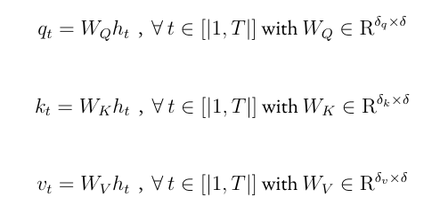
Self-Attention Layer
[<s> '▁Il',,"'",'▁entreprise','▁de','▁','plast','ur','gie', </s>]
h̃0
h̃1
…….
h̃t-1
h̃t
Self-Attention
h0
h1
…….
ht-1
ht
Embed
Embed
…….
Embed
Embed

Slide 33
Self-Attention Layer
Prediction
[<s> '▁Il',,"'",'▁entreprise','▁de','▁','plast','ur','gie', </s>]
Dense
Dense
…
Dense
Dense
h̃0
h̃1
…….
h̃t-1
h̃t
Self-Attention
h0
h1
…….
ht-1
ht
Embed
Embed
…….
Embed
Embed

Slide 34

Dense Layer
[<s> '▁Il',,"'",'▁entreprise','▁de','▁','plast','ur','gie', </s>]
FF
FF
FF
FF
h̃0
h̃1
…….
h̃t-1
h̃t
Self-Attention
h0
h1
…….
ht-1
ht
Embed
Embed
…….
Embed
Embed

Slide 35
Transformer
Prediction
[<s> '▁Il',,"'",'▁entreprise','▁de','▁','plast','ur','gie', </s>]
Dense
Dense
Dense
Dense
h̃0
h̃1
…….
h̃t-1
h̃t
Repeated x12/24 for Camembert
base/large
Self-Attention
h0
h1
…….
ht-1
ht
Embed
Embed
…….
Embed
Embed

Slide 36
Sequence Classification
Softmax
[<s> '▁l',,"'",'▁entreprise','▁de','▁','plast','ur','gie', </s>]
h0
h2
…….
ht-1
ht
Feed Forwad + Self-Attention Layers
Embed
Embed
…….
Embed
Embed

Slide 37
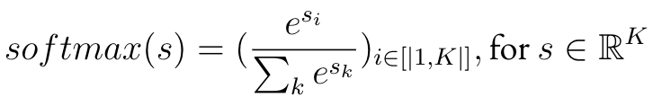
Sequence Classification: Output Function
We compute a distribution over the labels using the softmax function.
We have K=31 speech acts labels
s is also referred to as the logit vector

Slide 38
Sequence Classification: Output Function
We compute a distribution over the labels using the softmax function.
We have K=31 speech acts labels
s is also referred to as the logit vector
At test time, we make predictions by picking the label that has the maximum output likelihood (argmax)

Slide 39
Building a NLP Model
How do we segment the input text ?
We use sentencepiece tokenization which is a data-driven sub-word segmentation algorithm
How do we parametrize the model?
We use the transformer architecture
How do we train the model?
Training the transformers on sequence classification

Slide 40
Training for Sequence Classification
As most deep learning models, we train our model by:
Initializing all the parameters of the model
Defining a loss function to compare the prediction of the model with observed labels
Find the parameters of the model that minimize the loss with Gradient Descent NB: all the parameters are trained end-to-end

Slide 41
Sequence Classification
Softmax
[<s> '▁l',,"'",'▁entreprise','▁de','▁','plast','ur','gie', </s>]
h0
h2
…….
ht-1
ht
Feed Forwad + Self-Attention Layers
Embed
Embed
…….
Embed
Embed

Slide 42

Sequence Classification
Softmax
Cross-Entropy Loss
Label: Ask
[<s> '▁l',,"'",'▁entreprise','▁de','▁','plast','ur','gie', </s>]
h0
h2
…….
ht-1
ht
Feed Forwad + Self-Attention Layers
Embed
Embed
…….
Embed
Embed

Slide 43
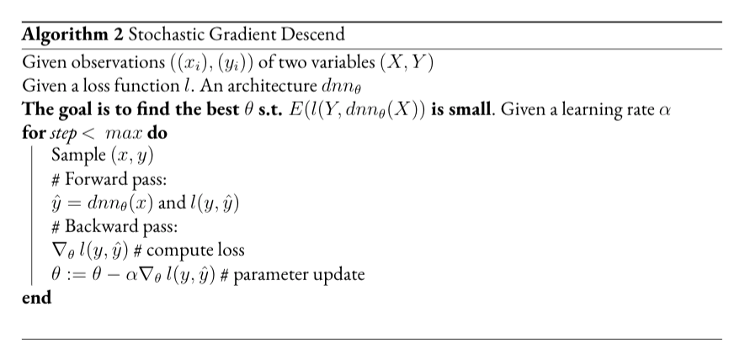
Training with Stochastic Gradient Descent
gradients

Slide 44
Training with Stochastic Gradient Descent
gradients

Slide 45
Stochastic Gradient Descent
gradients

Slide 46
Training with Stochastic Gradient Descent

Slide 47
Training with Stochastic Gradient Descent
Training step
Learning rate
In this tutorial, you will use Adam a variant of SGD to train our model.

Slide 48
How to initialize our Transformer?
Randomly initialize all the parameters and train all the parameters from scratch for Speech Act Classification
Limits: Training Transformers this way is suboptimal

Slide 49
How to initialize our Transformer?
Randomly initialize all the parameters and train all the parameters from scratch for Speech Act Classification
Limits: Training Transformers this way is suboptimal
Likely to overfit
Poor Generalization

Slide 50
How to initialize our Transformer?
Randomly initialize all the parameters and train all the parameters from scratch for Speech Act Classification
Limits: Training Transformers this way is suboptimal
Solution: Pretrain the transformer on Masked-Language Modeling

Slide 51
Finally: Camembert
Camembert is a large transformer model (300M+ parameters)
Pretrained with
a Masked-Language Modeling Objective
On 138 GB of Web-Crawled Data (32B tokens) in French (OSCAR)

Slide 52
Finally: Camembert
Camembert is a large transformer model (300M+ parameters)
Pretrained with
a Masked-Language Modeling Objective
On 138 GB of Web-Crawled Data (32B tokens) in French (OSCAR)
Camembert can be used as the initialization of any transformer architecture to build a model for French
In other words, Camembert can be fine-tuned (i.e. trained further) on any sequence labeling and sequence classification task

Slide 53
Pretraining of Camembert with MLM
Softmax
Cross-Entropy Loss
Label: métiers
[<s> '▁Il',,"y",'a,'▁des', [MASK],'pour,'tout’,'le’, ‘monde]
h0
h2
…….
h5
…….
ht-1
ht
Embed
Embed
…….
Embed
Embed

Slide 54
Fine-tuning of Camembert
Softmax
Cross-Entropy Loss
Label: Greet
[<s> '▁Il',,"'",'▁entreprise','▁de','▁','plast','ur','gie', </s>]
h0
h2
…….
ht-1
ht
Embed
Embed
…….
Embed
Embed

Slide 55
Camembert
Camembert is a large transformer model (300M+ parameters)
Pretrained with
a Masked-Language Modeling Objective
On 138 GB of Web-Crawled Data (32B tokens) in French (OSCAR)
Camembert can be fine-tuned (i.e. trained further) on any sequence labeling and sequence classification task
Camembert delivers state-of-the-art performance on multiple NLP benchmark for French

Slide 56
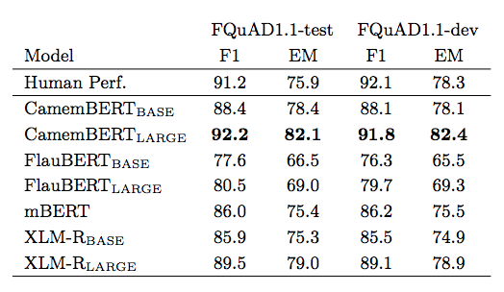
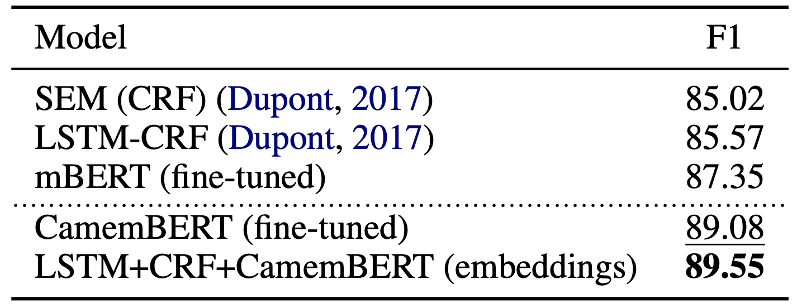
Camembert Performance on standard tasks
After pretraining, we can reuse the entire camembert model and fine-tune it on our task
Named-Entity Recognition
Question-Answering

Slide 57
In Summary
Camembert is a large transformers model
Pretrained with the Masked-Language Objective
That can be re-used for any sequence labelling or sequence prediction tasks
And likely to deliver good downstream performance

Slide 58

In Summary
Camembert is a large transformers model
Pretrained with the Masked-Language Objective
That can be re-used for any sequence labelling or sequence prediction tasks
And likely to deliver good downstream performance
In the next sessions of the tutorial
you will use the transformers library to download and play with it!
We showcase camembert for dialog act classification but the same approach can be used for any sequence classification or labeling task

